Slide 1
Annual Meeting 2022 Championing what matters to you 2021 - 2022
Notes:
Thank you for coming to our Annual Meeting today.

Slide 2
Welcome
Morcea Walker
MBE, VLL

Slide 3
Agenda
Welcome
Introduction to the Advisory Board and staff
Last year’s key challenges
Looking back 2021/2022
Our budget
Our plans for 2022/2023
Questions

Slide 4
Challenges
Pandemic
End of contract June 2021
Re-awarded contract to 31st October 2023
Static budget £195k per annum
New Advisory Board
Rebrand to Healthwatch North and West Northamptonshire
Staff changes

Slide 5
Looking back at 2021-22

Slide 6
Our year in numbers…
707 people engaged with us and shared their experiences of health and social care services, helping to raise awareness of issues and help improve care.
12,941 visits to our social media pages (including Young Healthwatch Northamptonshire) that include information and advice about topics such as mental health and COVID-19.
4 reports were published about the improvements people would like to see and social care services.
Our carers report was our most popular project which highlighted the struggles people have caring for others and since the pandemic.
We’re lucky to have 39 volunteers who gave up their time to improve care for Northamptonshire residents.
1345 hours were spent volunteering

Slide 7
Our volunteers….
Healthwatch Advisory Board
Planning Group - develop strategy, deliver work plan, lead project task and finish groups
Ensure delivery of our statutory role and functions
Use their experience and expertise, attending various boards and committees
Proactively gather, listen and represent the views and experiences of local people
Ensure the voice of local people is championed at every opportunity
Notes:
Our volunteers are local people who are dedicated to support and improve health and social care services in Northamptonshire. Volunteers represent us at nearly 50 different meetings across the county and are the foundation of our organisation. They are involved at every level of our work, including the planning and decision making. This year they carried out 46 visits, including to hospital wards, a mental health inpatient service, crisis houses and crisis cafés. Our volunteers have also assisted with the designing and distribution of surveys and have attended 17 engagement and outreach events.

Slide 8
How we’ve made a difference:
We teamed up with Northamptonshire Carers and Carers’ Voice to find out more about carers’ experiences during the pandemic
Young Healthwatch looked into young people’s mental health and wellbeing and developed staff training programmes
Teaming up with Northamptonshire CCG we gathered feedback on the NHS First 111 system
We attended local dental meetings with updates from NHS England so that we could share that information with the public
We shared information with different communities to better understand the COVID-19 vaccination programme
Notes:
A brief overview of our work in the past year.

Slide 9
Making NHS First 111 more accessible in Northamptonshire
Northamptonshire CCG asked us to find out what people thought of the NHS 111 First service, particularly those who have hearing loss, impaired vision, or other accessibility challenges. 131 people responded. Issues included:
Difficulty understanding the automated menu
The link to interpreters, British Sign Language and Easy Read
4 recommendations were made to improve the service.
Full report on our website www.healthwatchnorthamptonshire.co.uk

Slide 10
Making experiences better for carers since the pandemic
Together with Northamptonshire Carers and Carers’ Voice Northamptonshire, we asked carers’ more about their experiences and needs through a survey, interviews, and a consultation event.
Carers told us that their physical, mental and emotional wellbeing had suffered from the extra strain on them, and many were concerned about the worsening condition of those they cared for, exasperated by the reduction in health and care services and the need to stay away from others, or the anxiety caused by the pandemic.
“I would like to thank you for doing this research. No-one has really asked me how I’ve coped this year caring for my parents. I have muddled along and it is only when I answer your questions that I realise how tough it has been”.
The report has been shared with the main providers of health and care in the county and those that plan and make decisions. This feedback will help inform future improvements.

Slide 11
Advice and information
This year we helped people by:
Providing up to date information on COVID-19
Linking people to reliable information they can trust
Helping people to access the services they need
Helping people to understand the complaints and compliments process
Helping people to understand why they can’t get a dental appointment
Providing information about where they can go for urgent dental care
Notes:
People can contact us by phone, text, email or via social media and our website.
Healthwatch plays an important role in providing information and advice as well as signposting people in the right direction.
People contact us about GP services, dental care, hospital care, social care.
When safeguarding issues are raised, we make referrals.

Slide 12
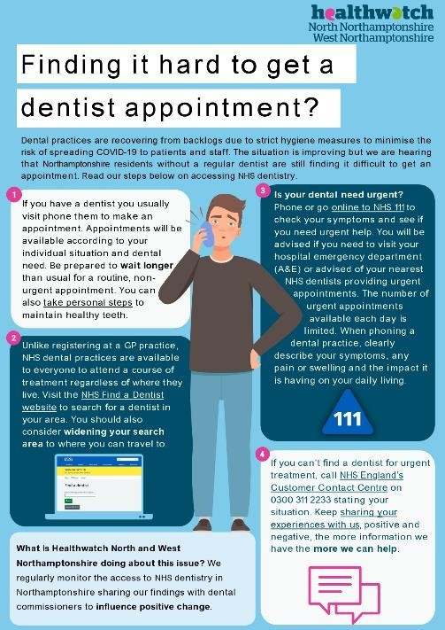
How we helped the public this year
The ongoing problem with accessing dental appointments:
With the continuous increase in people telling us that they are struggling to get a dentist appointment, we have continued to inform the public about why this is happening.
We have shared information about urgent care hubs across Northamptonshire, as well as an infographic (right) explaining why people may experience this problem.
This has helped with the public’s frustrations when calling us for help. With one person saying:
“…well if anything I am glad for this information. Although I am angry, at least I know why.“ – Public enquirer
Notes:
We signposted people to organisations that would further support them to access the advice and information they need. Most people asked for information about how to make a complaint about a health or care service they have used and were signposted to VoiceAbility for NHS Complaints Advocacy support, local NHS Trust Patient Advice and Liaison Services (PALS) and NHS England customer contact centre.
We have also signposted people to services they can self-refer to and organisations such as the Local Government and Social Care Ombudsman, Northampton County Council Adult Social Care, Mind and Crisis Cafés, Citizen’s Advice, Community Law, Young Minds, Age UK, Northamptonshire Carers, Maternity Voice Partnership, Macmillan Cancer Care, Northamptonshire Domestic Abuse Service, Alzheimer’s Society, the General Dental Council, the General Medical Council, the General Pharmaceutical Council, and local community transport schemes.
This year we also made one safeguarding referral to the County’s Safeguarding Team with the enquirer’s permission, and contacted the team about two other cases.

Slide 13
Helping people understand their rights
Despite seeing an increase in online communication about health services in Northamptonshire since the pandemic, we were still contacted by people who were confused about their right to access to services.
In 2021-2022 we were able to post and deliver access to healthcare cards to people who did not have a home address or identification. In doing so people were able to get the care they needed and share this information with others.

Slide 14
Our volunteers
Support staff
Represented us at stakeholder and service provider meetings
Kept us up to date with local information
Helped people have their say
Helped us achieve Investing in Volunteers re-accreditation
Young Healthwatch Northamptonshire
Youth Advisory Board for the Children’s Transformation Programme

Slide 15
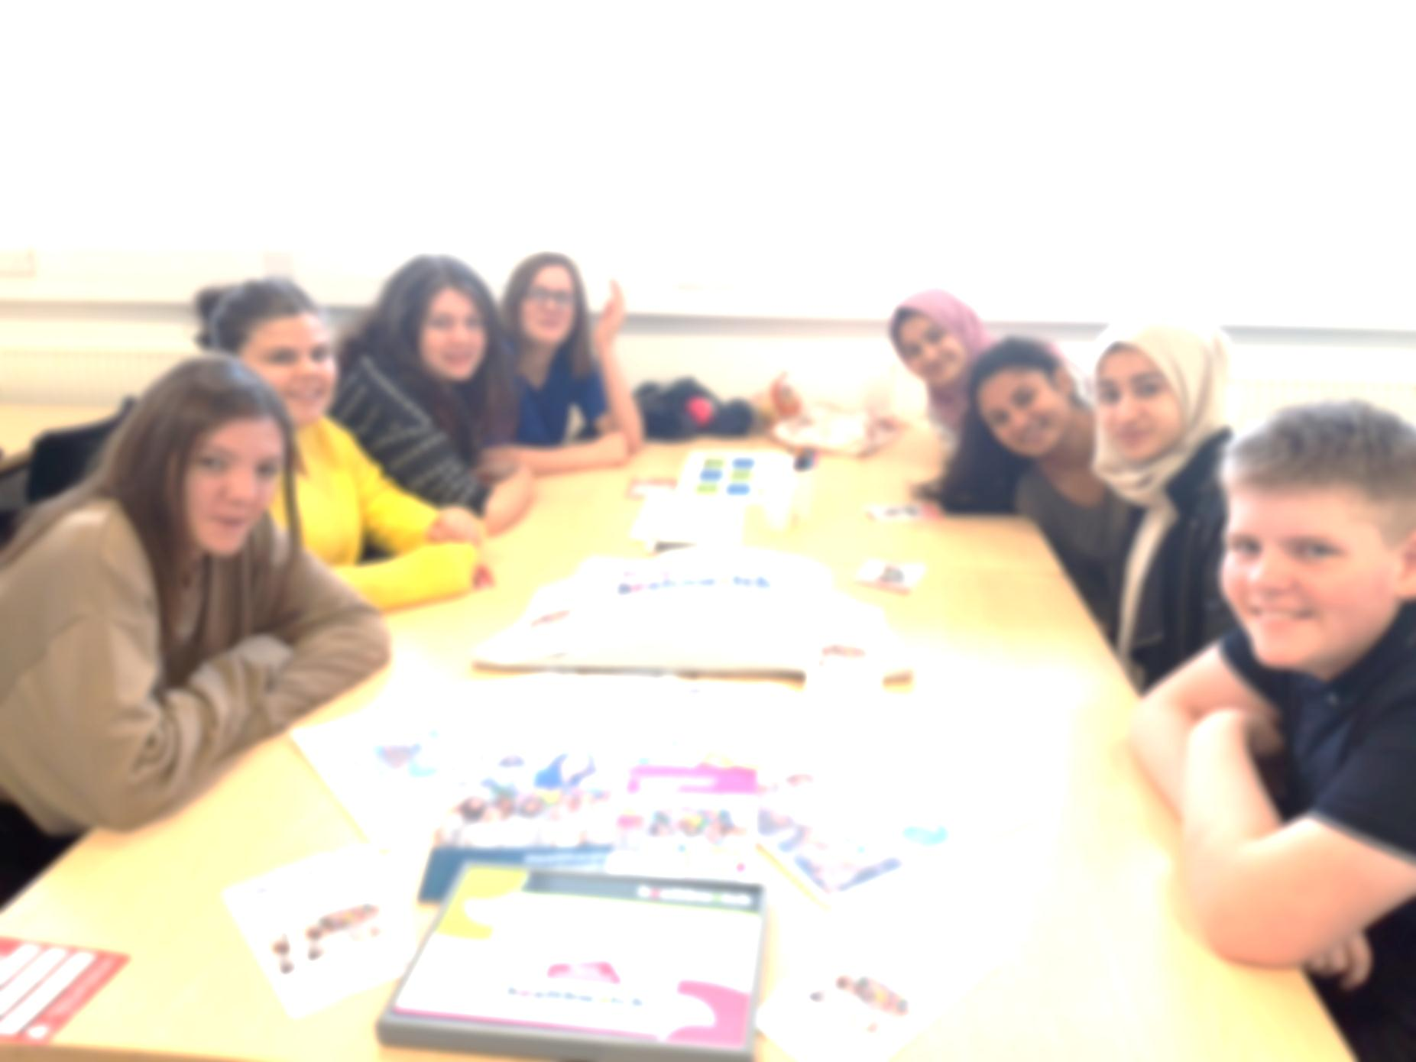

Slide 16
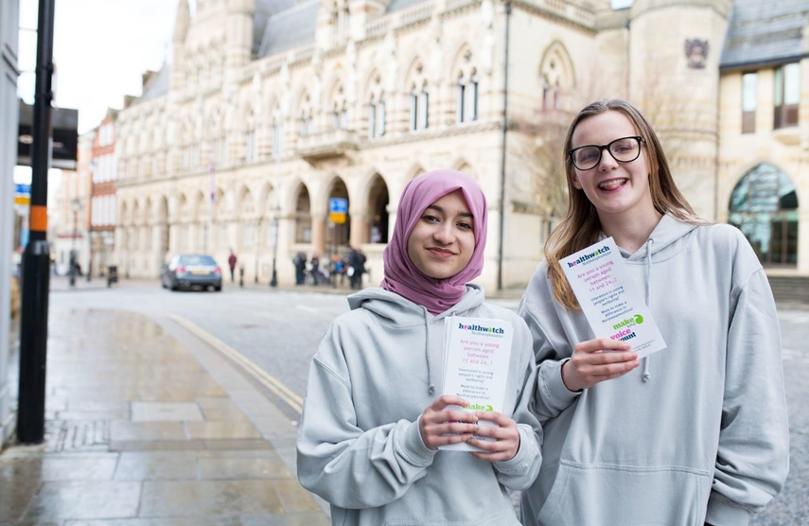
About us…
We live in Northamptonshire
11 – 24 year olds
We want to make a difference locally
We get views from other young people

Slide 17
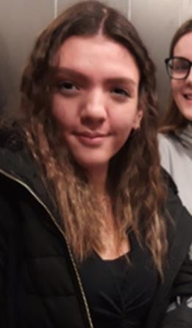
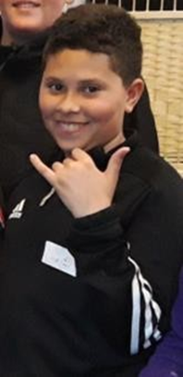
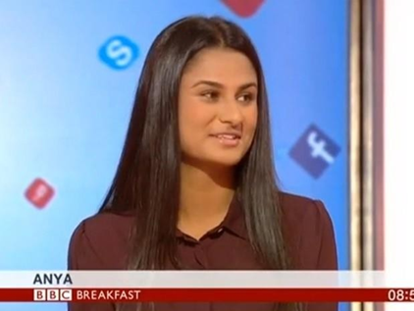
Some words from our young volunteers
“I’ve been given so many opportunities that wouldn’t have happened otherwise, it’s a good way to get a bit of experience.” - Layla
“I volunteer with Healthwatch to be educated on people who are in different positions to me. I also like to be able to help with issues concerning young people.” - Darrell
“I’ve stood up and done meetings and presentations, and because I have a voice it’s built-up confidence”. One volunteer said that she’d been on BBC Breakfast and worked with the Royal Society of Public Health.” – Anya

Slide 18
Improving young people’s transition from youth to adult mental health services
Young Healthwatch sought to hear from a group of children and young people to discover their thoughts, views and experiences of the transition between CYP mental health services (Child and Adolescent Mental Health Services – CAMHS), to adult mental health services – how it felt, how it worked or didn’t work, and how it could be improved. They also sought the thoughts, views and experiences of those leaving care about the preparation, the process, the aftercare, and how their experiences continue to affect them today.
What they found:
All the young people they spoke to struggled with the transition from CAMHS to adult mental health service, with some experiencing a decline in their mental health and physical health, exaggerated by the stress of the process. They reported that they felt abandoned, unsettled and confused and found the process stressful. This information was fed back to Northamptonshire CCG via a hard-hitting series of short films, where the feedback came directly from the young people themselves. These videos will be used internally to train staff and inform how the current mental health pathway for children and young people could be improved in the near future.

Slide 19
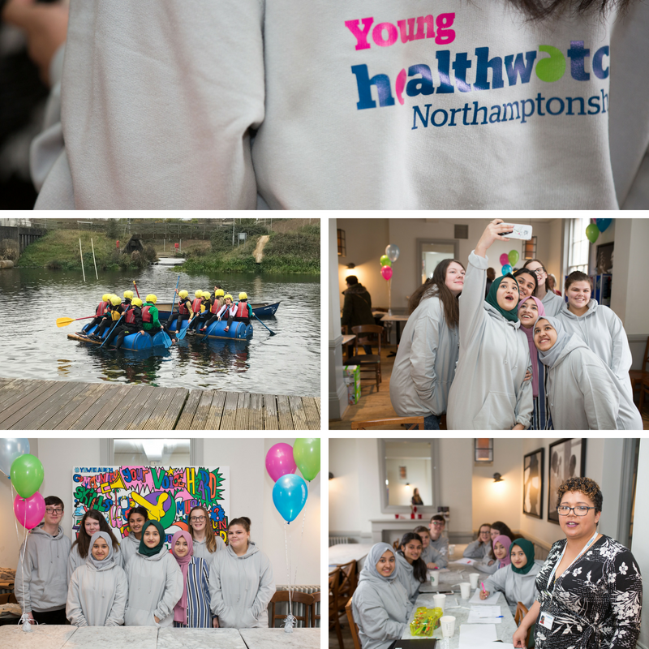
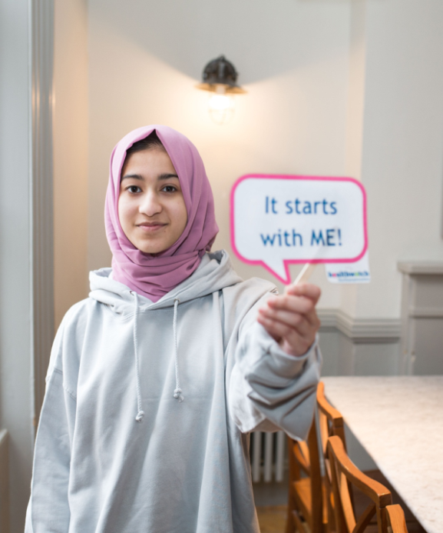
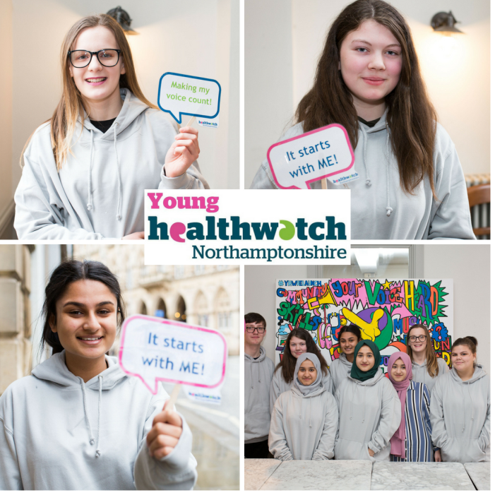
Thank you Young Healthwatch!!

Slide 20
Looking forward 2022-23

Slide 21
Top priorities for 2022-23
Gathering patient experience on access to GP appointments
The development of an Integrated Care System (ICS)
Working with the ICB and ICP
Integrated Care Across Northamptonshire (iCAN)
2 Health and Wellbeing Boards
The impact of COVID-19 on people and the resumption of services
Young Healthwatch Project in East Northants
To keep a watching brief and request provider updates on access to NHS Dentistry
Resume Enter and View

Slide 22
Finance
Income |  | Expenditure
Funding received from local authority | £195,000.00 | Staff costs | £172,995.58
Additional funding | £60,028.00 | Operational costs | £37,050.51
 |  | Support and administration | £16,433.21
TOTAL | £255,028.00 | TOTAL | 226,479.30
Total expenditure exceeded core local authority funding by £31,479.30

Slide 23
Questions
Notes:
Hand back to David.

Slide 24
Thank you!
Volunteers
Young Healthwatch
Staff
We can’t do any of this without you!

Slide 25
Thank you for attending, we look forward to seeing you in person next year!

